Slide 1
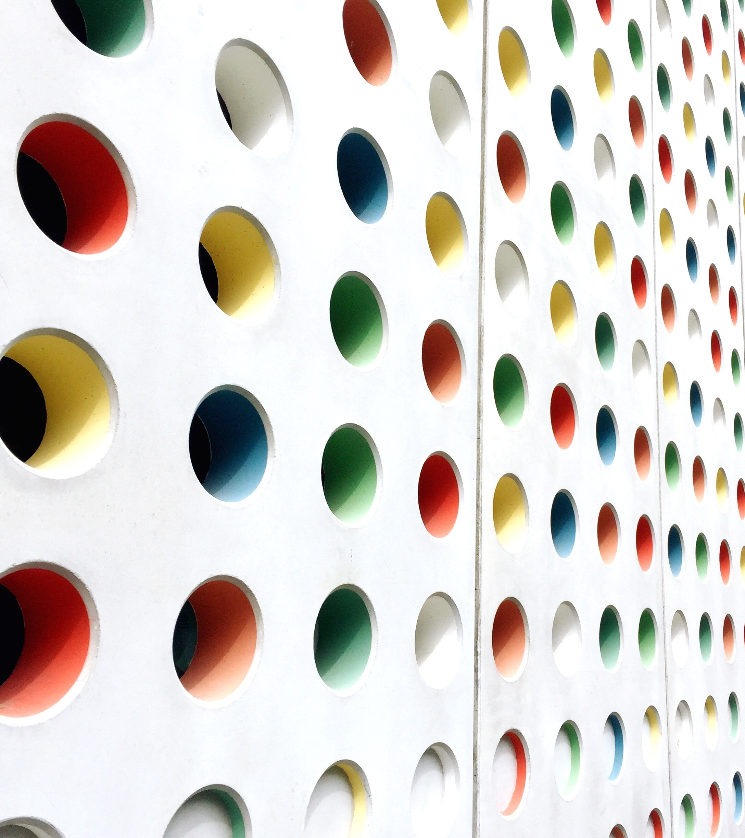
Digital Fabrication Project
Miniature Pagoda

Slide 2
Project Members
Group Number - 43
Rahul Aryan – CH20BTECH11028 - Modelling the project
Pranav K Nayak – ES20BTECH11035 - Modelling the project
Varad Yergole – CH20BTECH11038 - Modelling the project
Gautham Bellamkonda – CS20BTECH11017 - Collecting time and material estimates
Varenya Upadhyaya – EP20BTECH11026 - Preparing the presentation

Slide 3
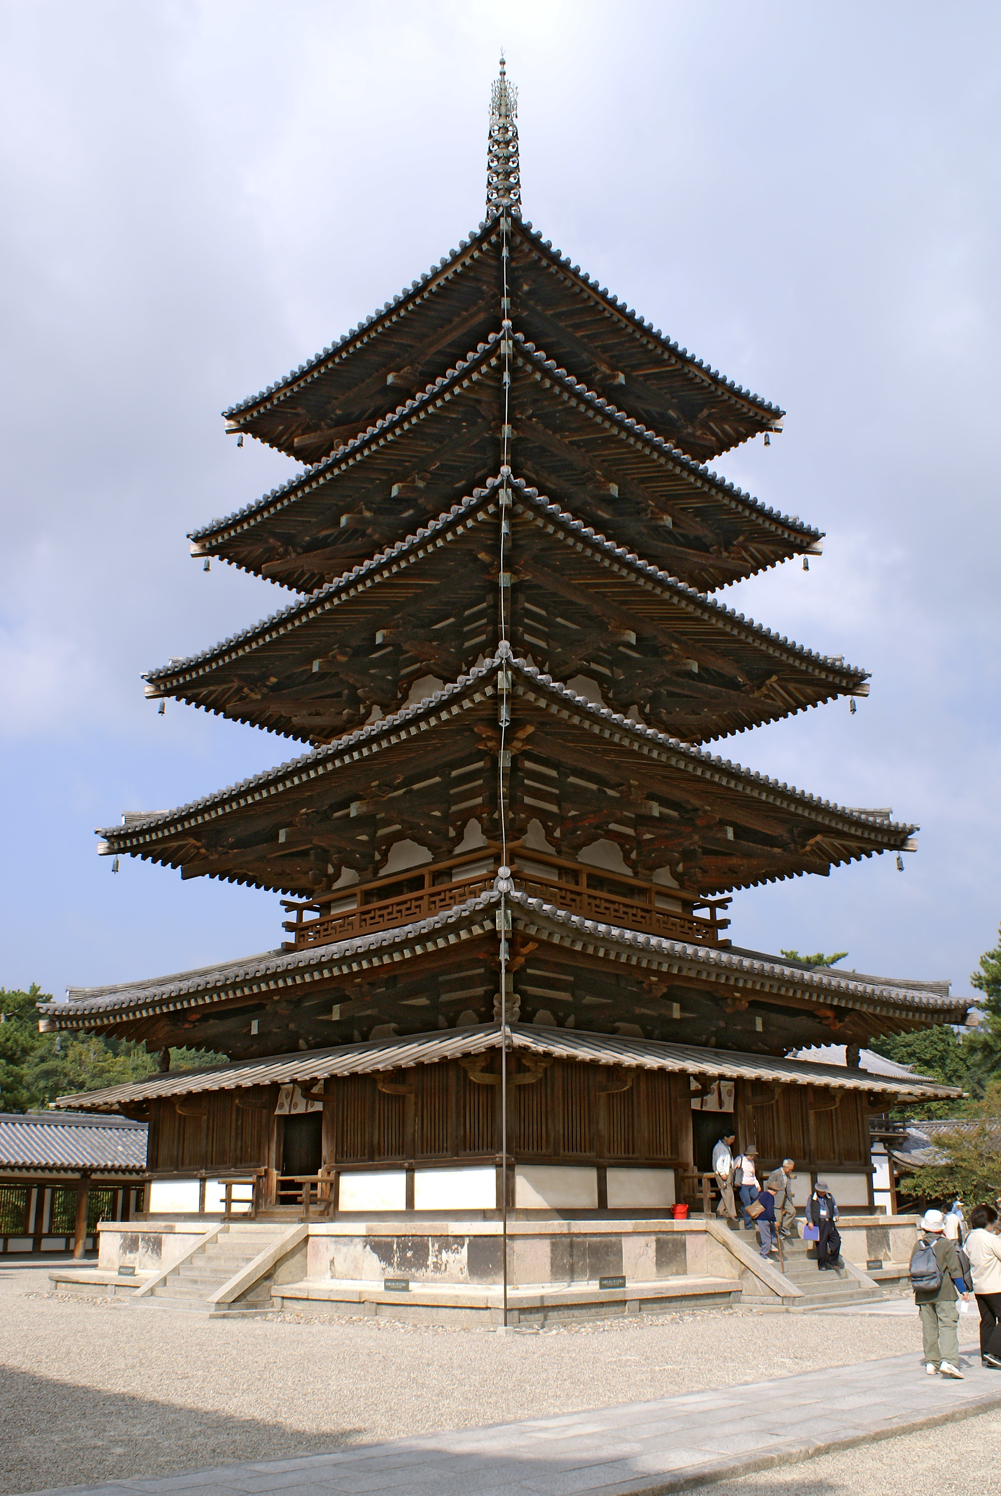
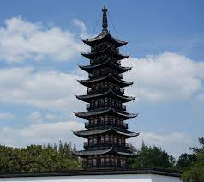
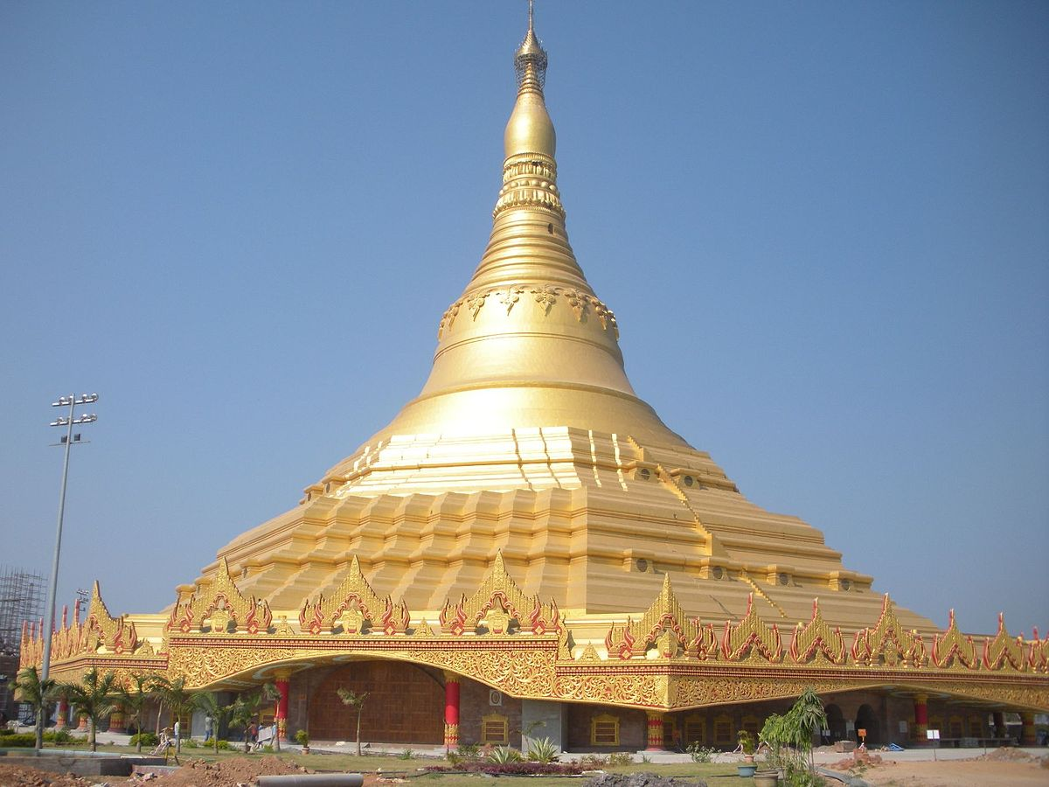
Pagoda
A pagoda is a tiered tower with multiple eaves common to China, Japan, Korea, Vietnam and other parts of Asia.
The pagoda structure derives from that of the stupa, a hemispherical, domed, commemorative monument first constructed in ancient India.
Initially, these structures symbolized sacred mountains, and they were used to house relics or remains of saints and kings. Stupas evolved into several distinct forms in various parts of Asia.

Slide 4
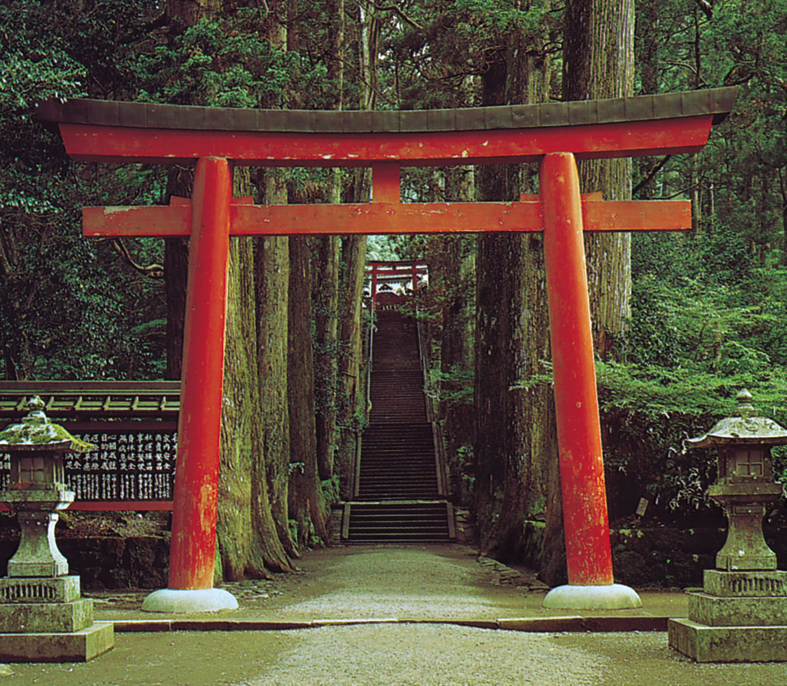
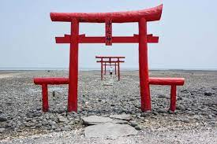
Torii
A torii is a traditional Japanese gate most commonly found at the entrance of or within a Shinto shrine, where it symbolically marks the transition from the mundane to the sacred.
The function of a torii is to mark the entrance to a sacred space.
Torii gates were traditionally made from wood or stone, but today they can be also made of reinforced concrete, copper, stainless steel or other materials.

Slide 5
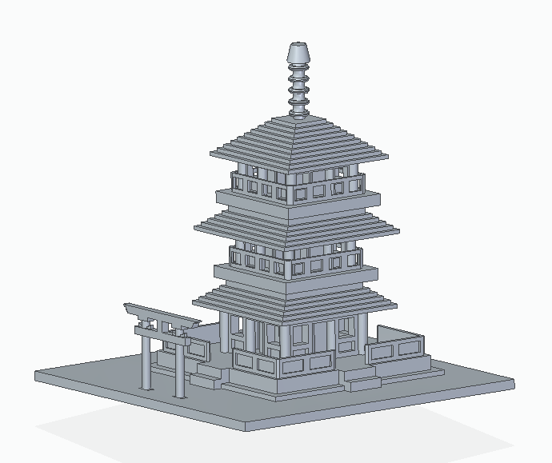
Our 3D Model Project
Our model is a miniature version of these two architectural structures, the pagoda and the torii.

Slide 6
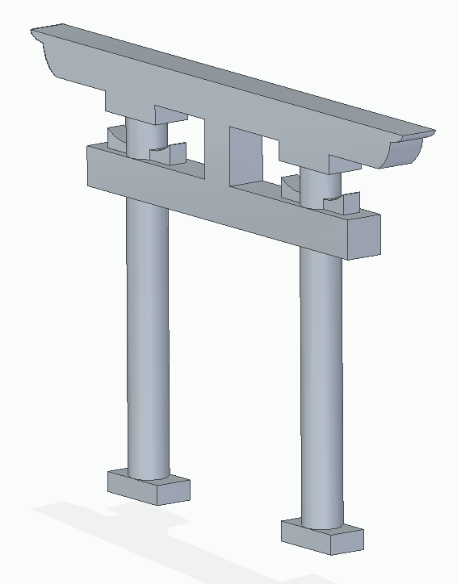
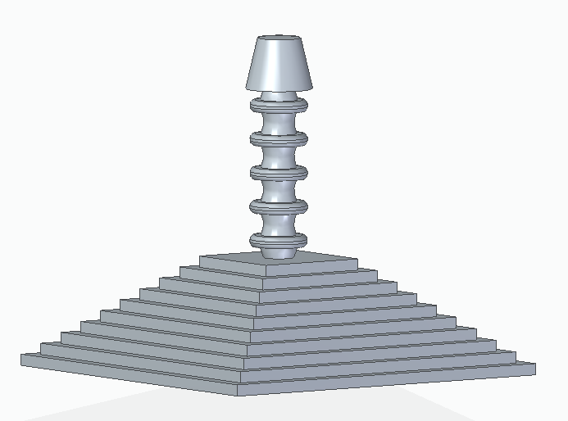
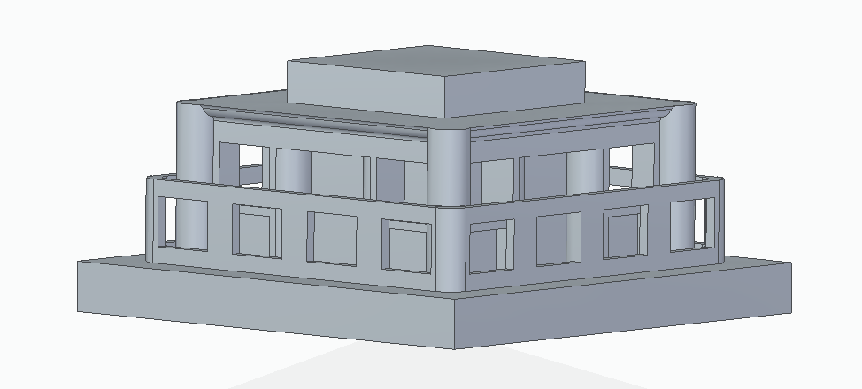
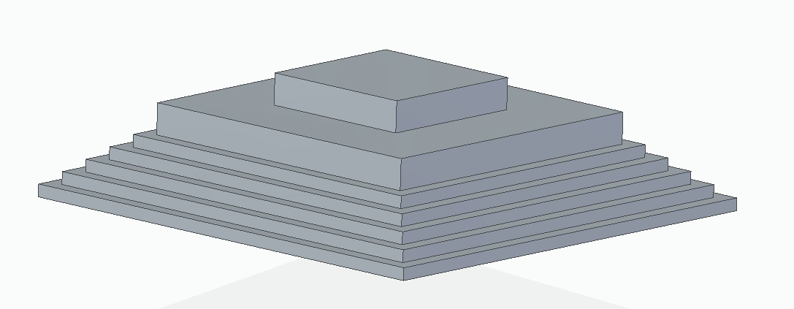
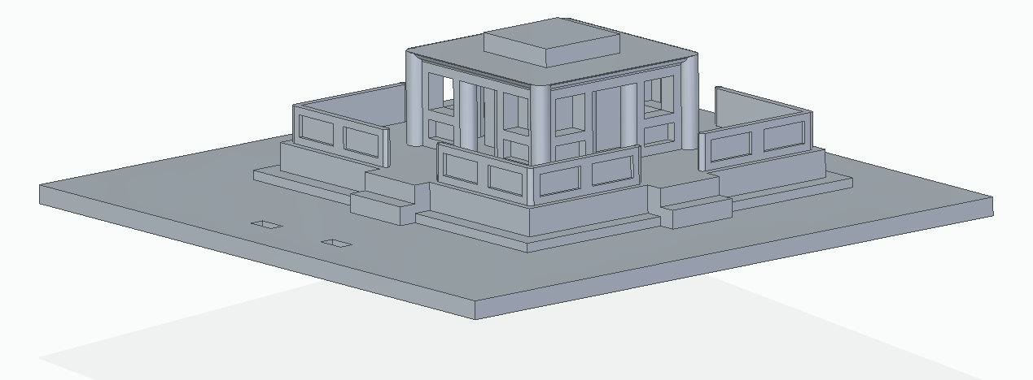
Some Features of the Project
The model consists of tiers of the pagoda and the torii as parts which assemble to give the final model.
All the parts have grooves and extrusions which can be fit into each other to form the miniature pagoda

Slide 7
Advantages in the Design
Printing out different parts and assembling them later has several benefits:
Lesser support material required
Lower print time
The model can be customized to add/reduce tiers
Interaction with the model is increased as the user gets to build the model (akin to a Lego model)

Slide 8
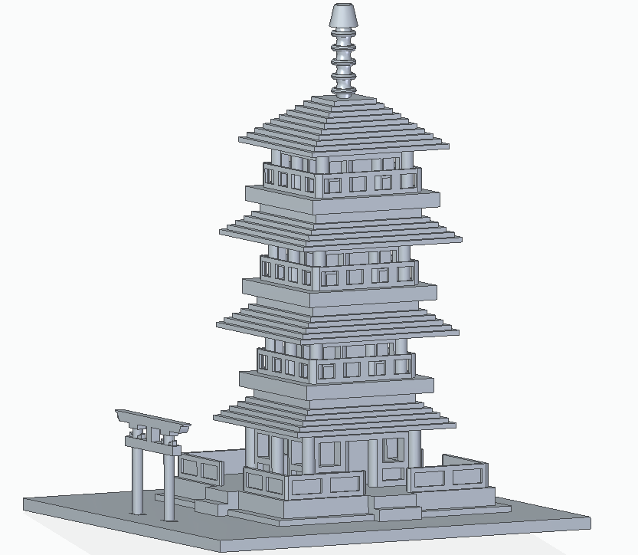
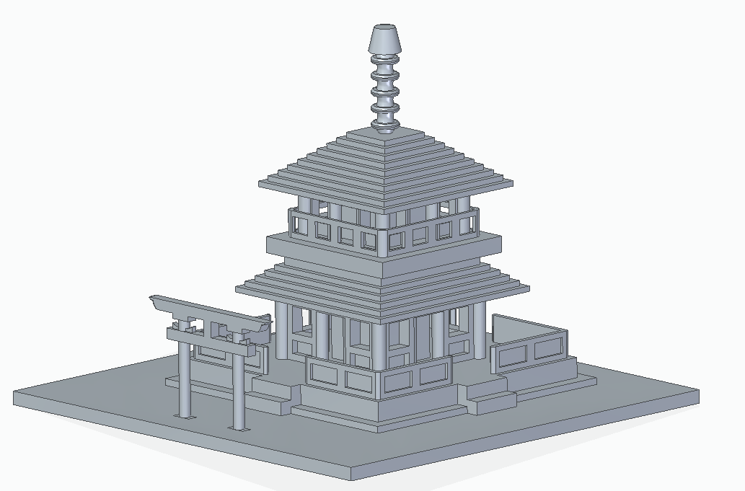
Modular Design
Since the model is divided into smaller tiers/modules, many types of Pagoda can be made with different amounts of the mid-floor and mid-roof printed. Here are some of the examples:

Slide 9
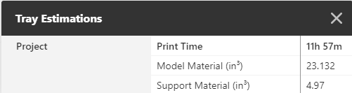
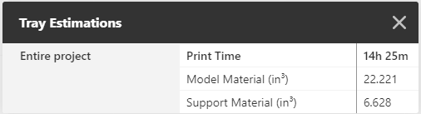
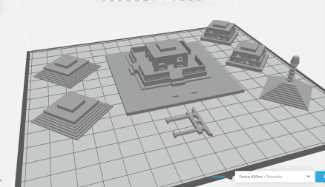
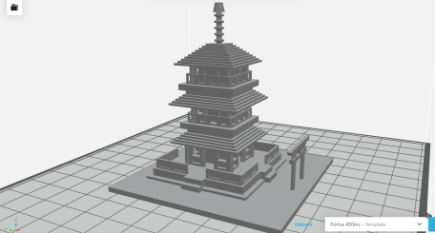
Grabcad Screenshots
The screenshots of the models and trays estimations can be seen on the left.
The first set is the case where the parts are printed out separately (optimal option).
The second set is the case where the entire model is printed at once.

Slide 10
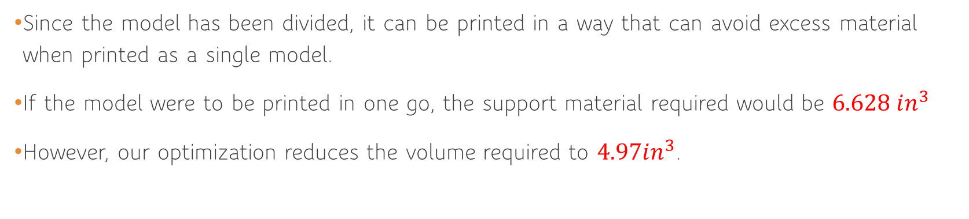
Printing Material Reduction
Since the model has been divided, it can be printed in a way that can avoid excess material when printed as a single model.
If the model were to be printed in one go, the support material required would be $6.628 in^{3}$
However, our optimization reduces the volume required to $4.97in^{3}$.

Slide 11
Printing Time Reduction
As mentioned earlier, printing the parts separately also reduces the time required.
The required time for printing the model in one go is 14h 25m
In contrast, the printing time for the optimized model is 11h 57m , a nearly 3-hour reduction

Slide 12
In conclusion
Our project- The Pagoda 3D model is a showpiece based on a similar Japanese building.
The model was optimized by separating the different parts, printing them out and then assembling them.
This approach reduced both time and support material.
Thank you!

